Slide 1
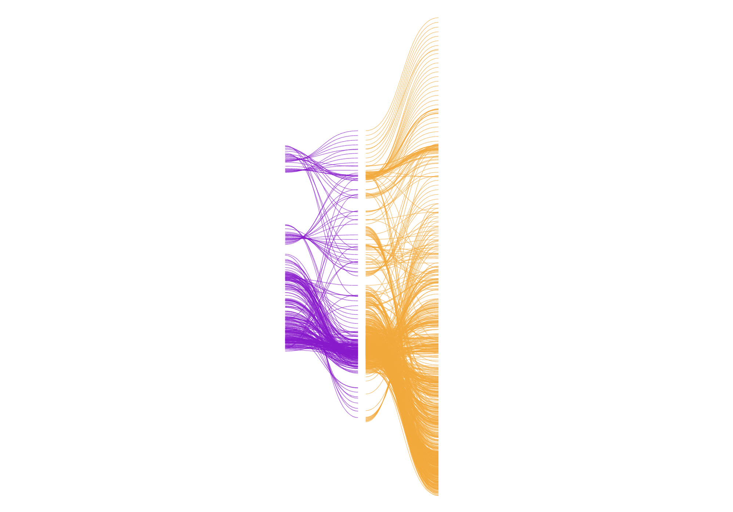

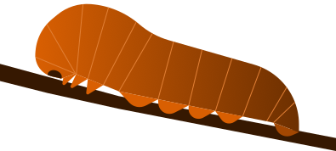

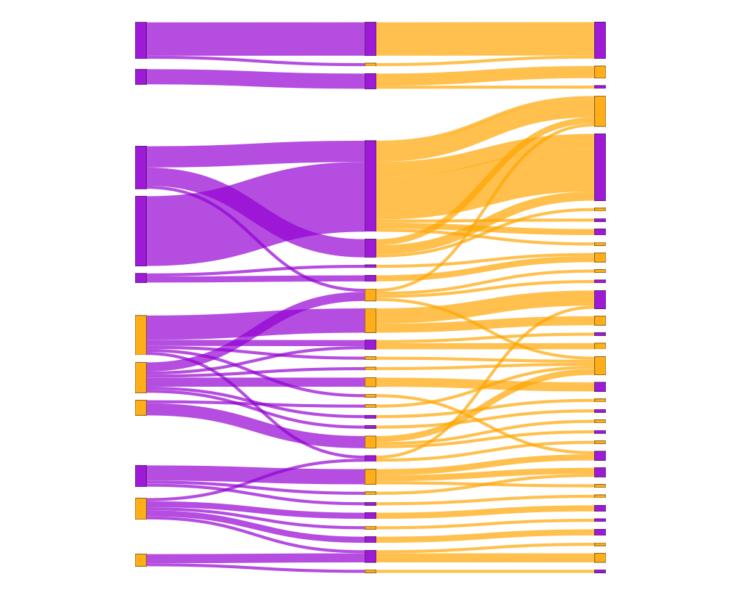

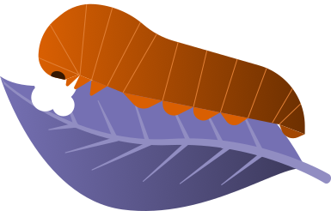
A) Metaweb of all trophic interactions
C) Species beta diversity
B) Sampling sites and local trophic networks
D) Beta diversity of interactions

Slide 2
A) Metaweb of all trophic interactions
C) Species beta diversity
B) Sampling sites and local trophic networks
D) Beta diversity of interactions

Slide 3




Slide 6
A) Metaweb
C
B
D

Slide 8

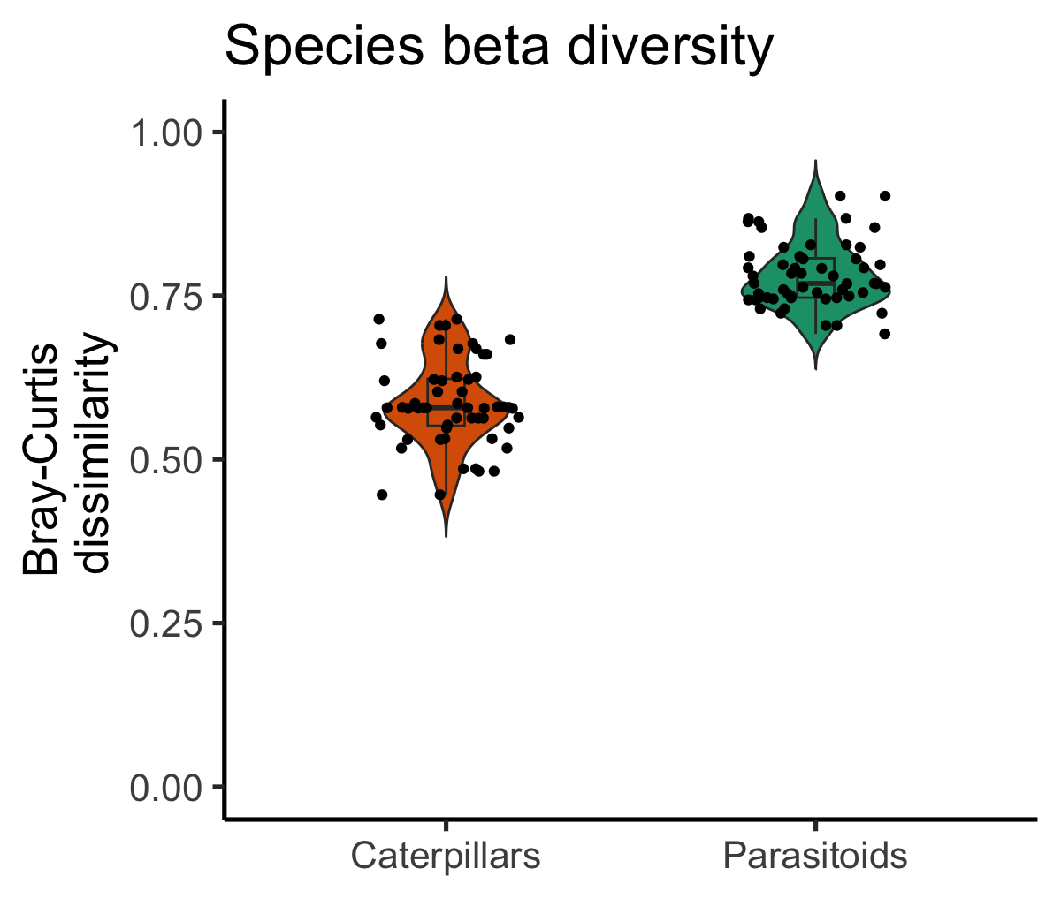
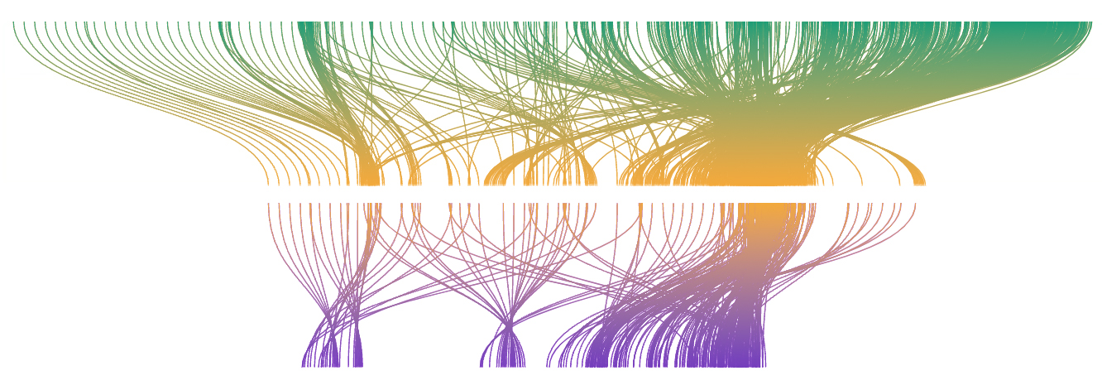
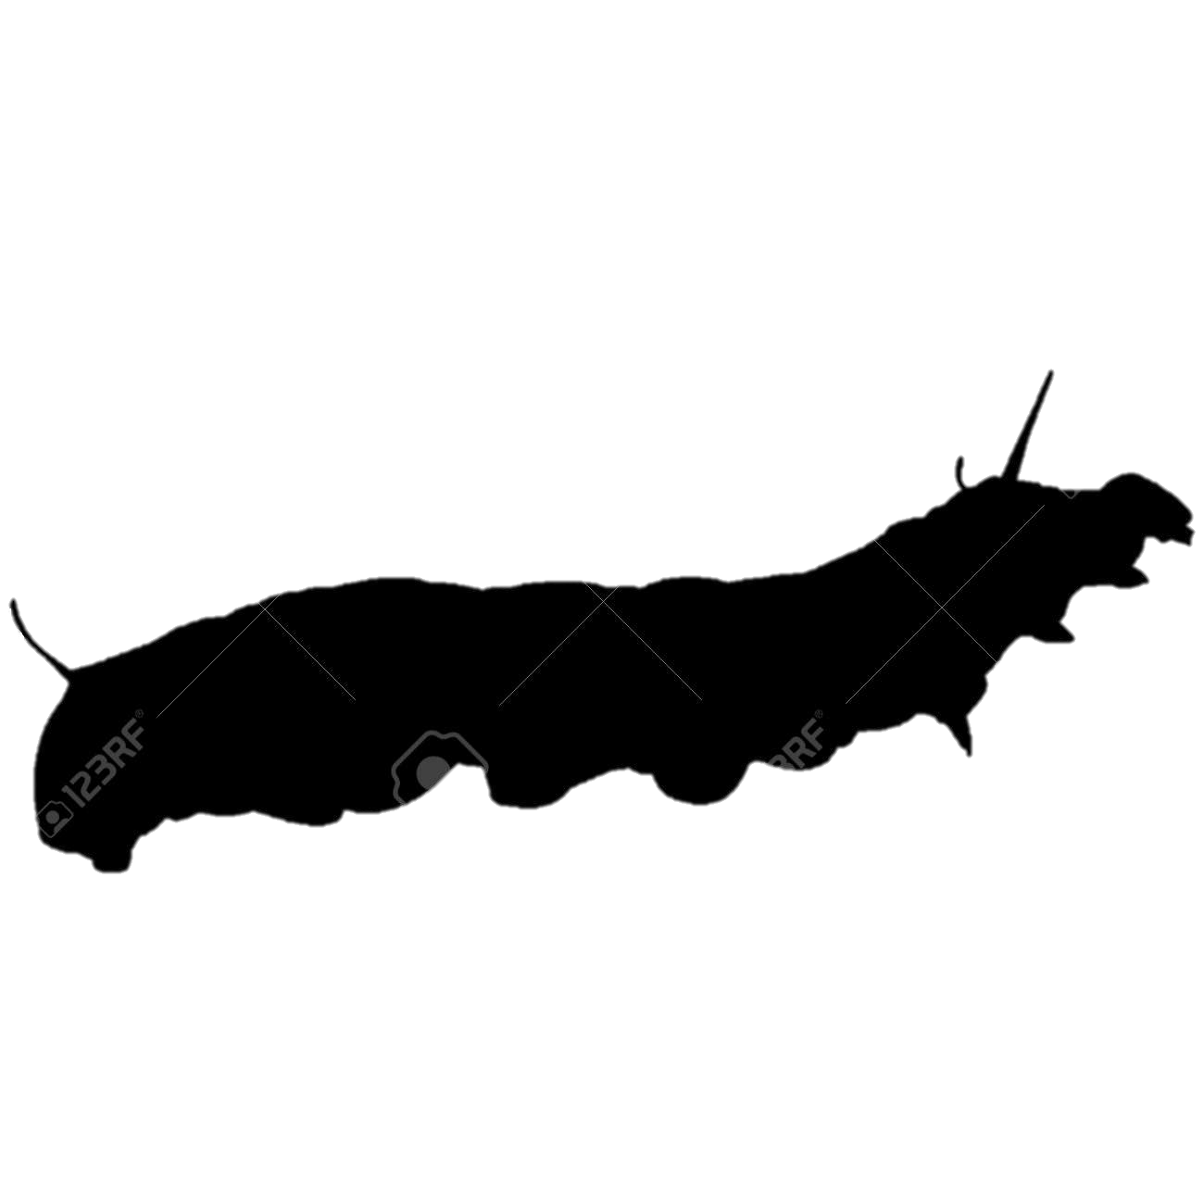

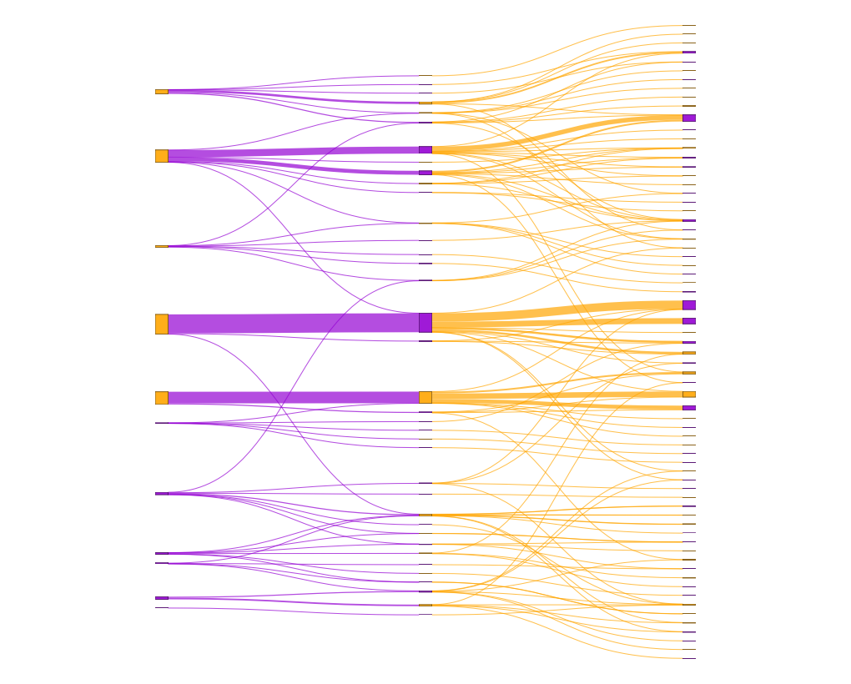
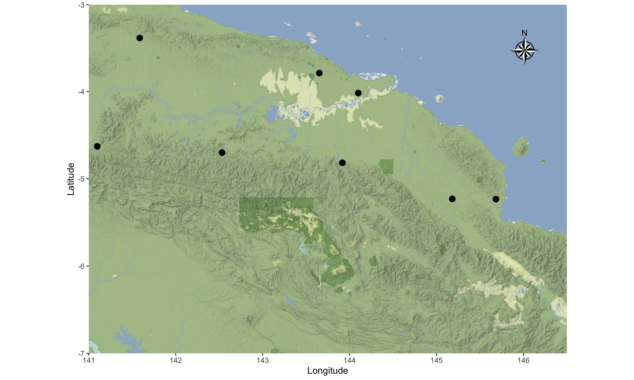
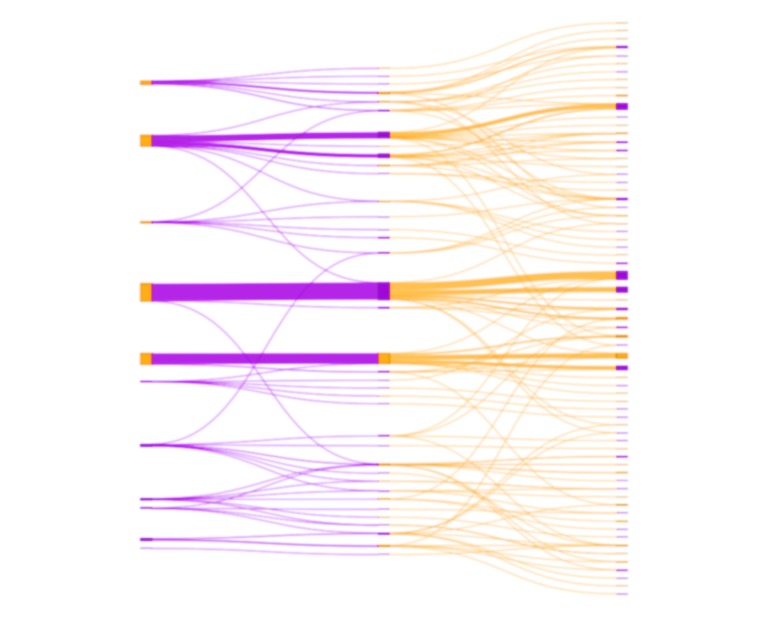
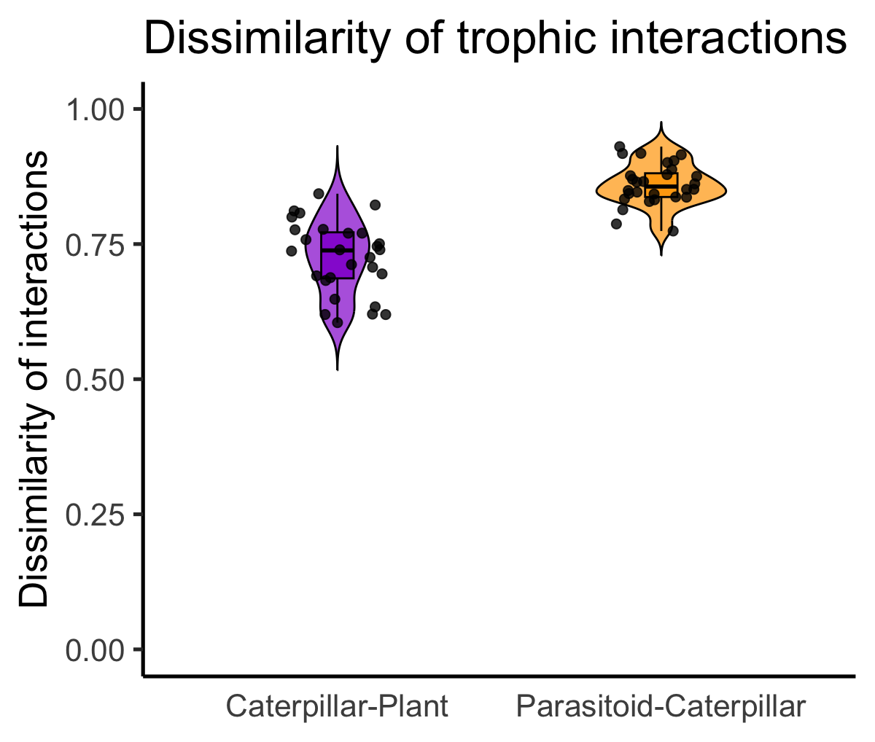
A) Metaweb

Slide 9
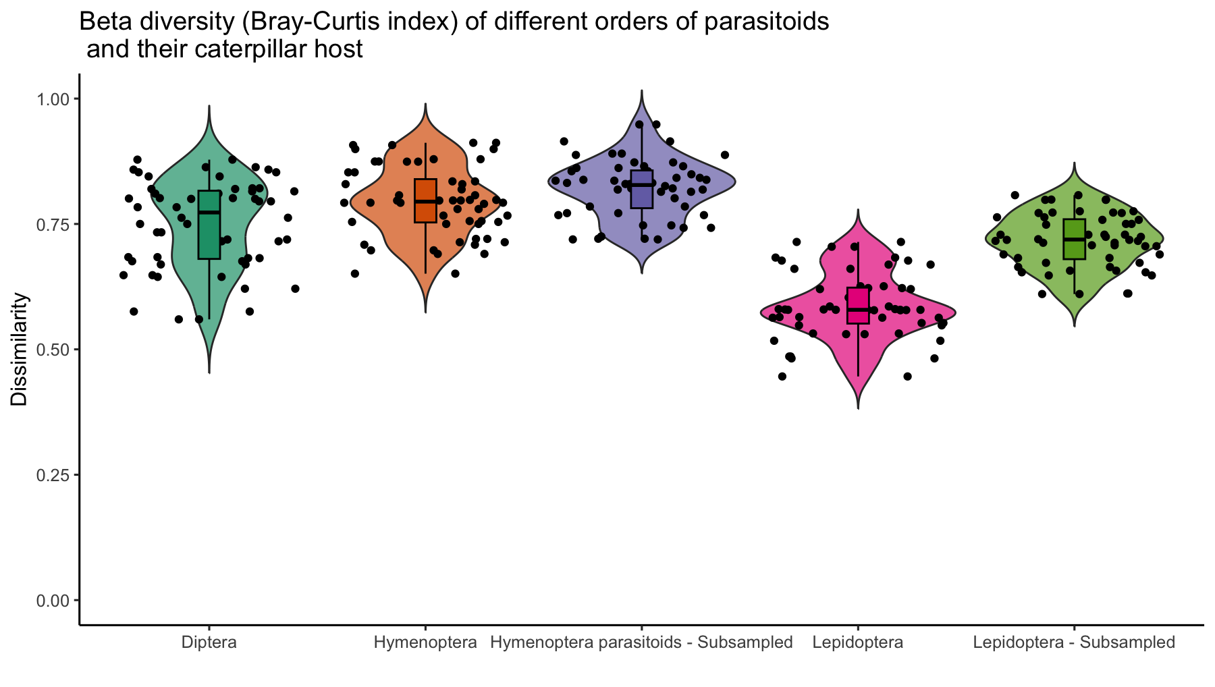
Figure S X: Beta diversity (Bray-Curtis index) of parasitoids (Hymenoptera and Diptera), and their caterpillar host (Lepidoptera). The “subsampled” groups correspond to resampled datasets matching the abundance of Diptera parasitoids at each locality.

Slide 10
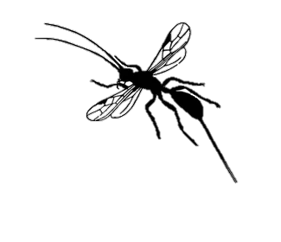
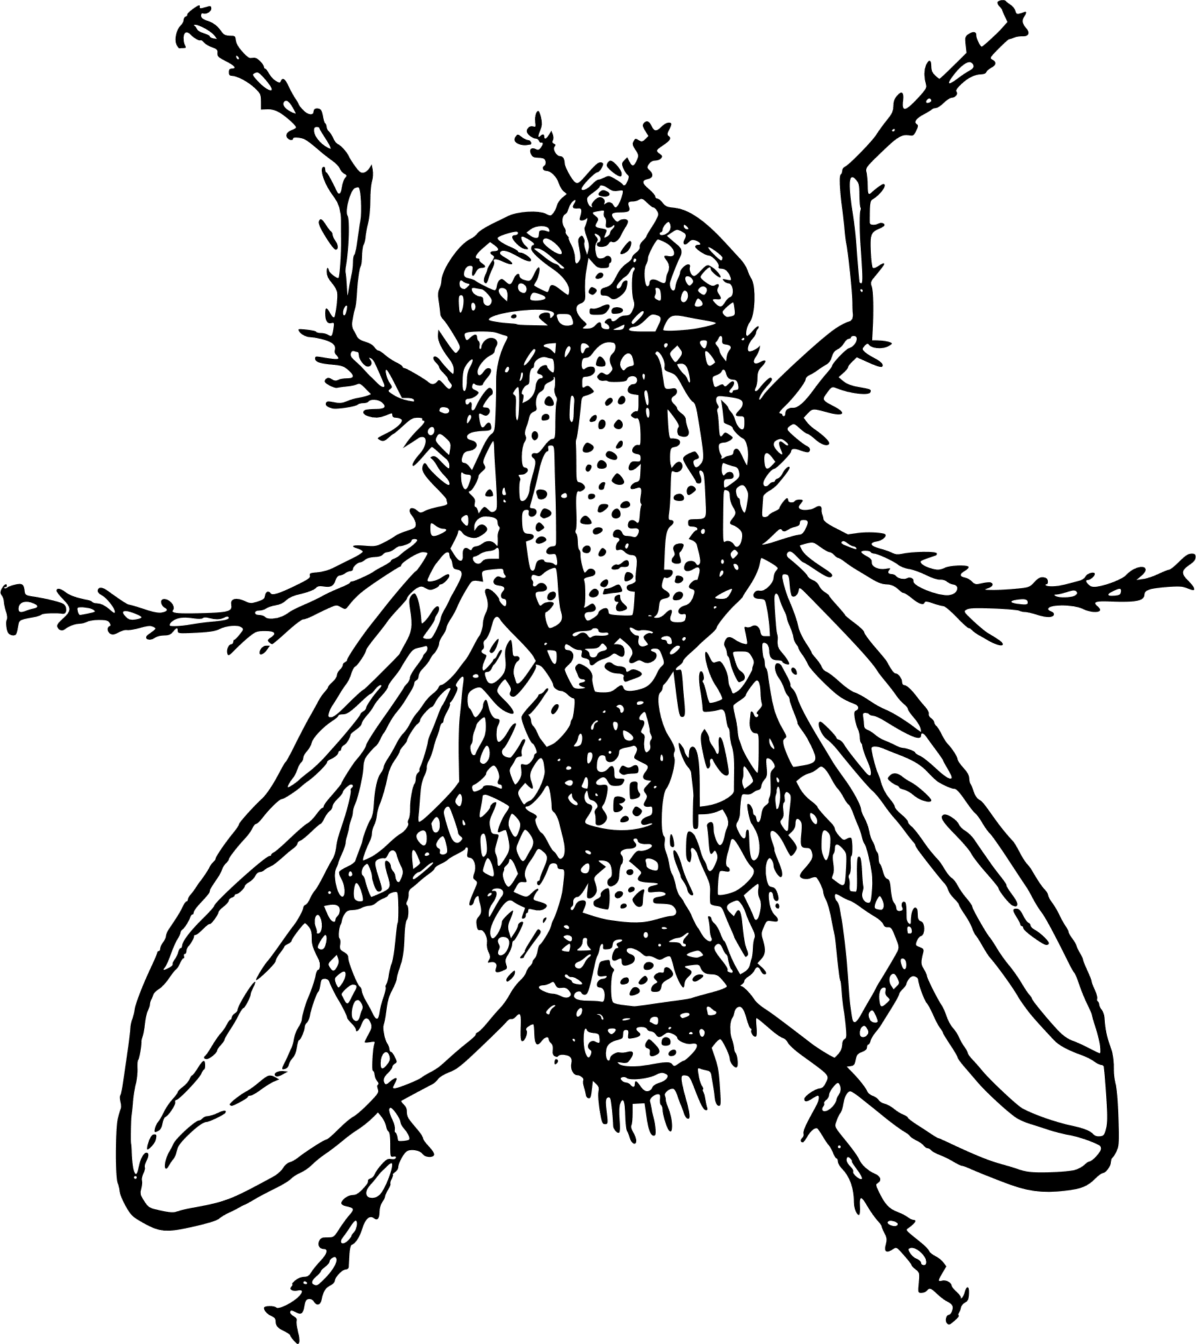
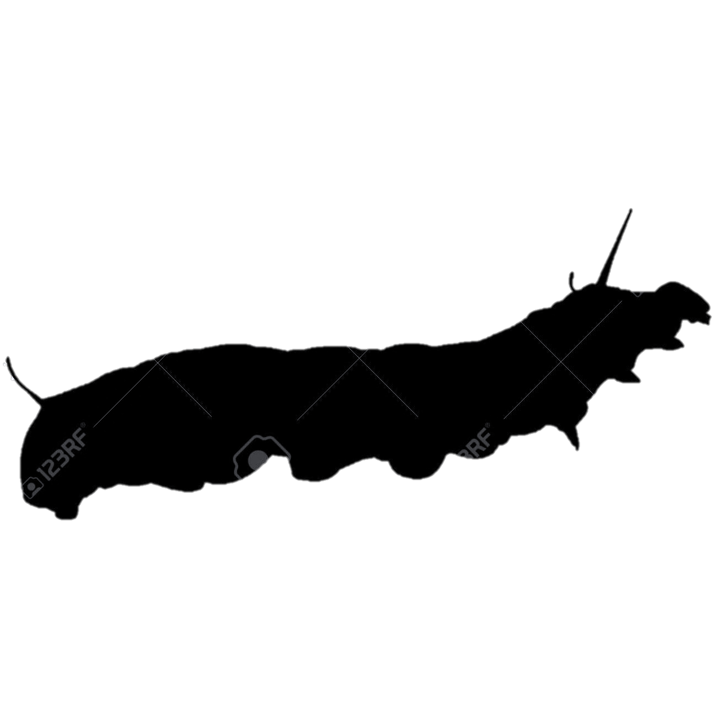

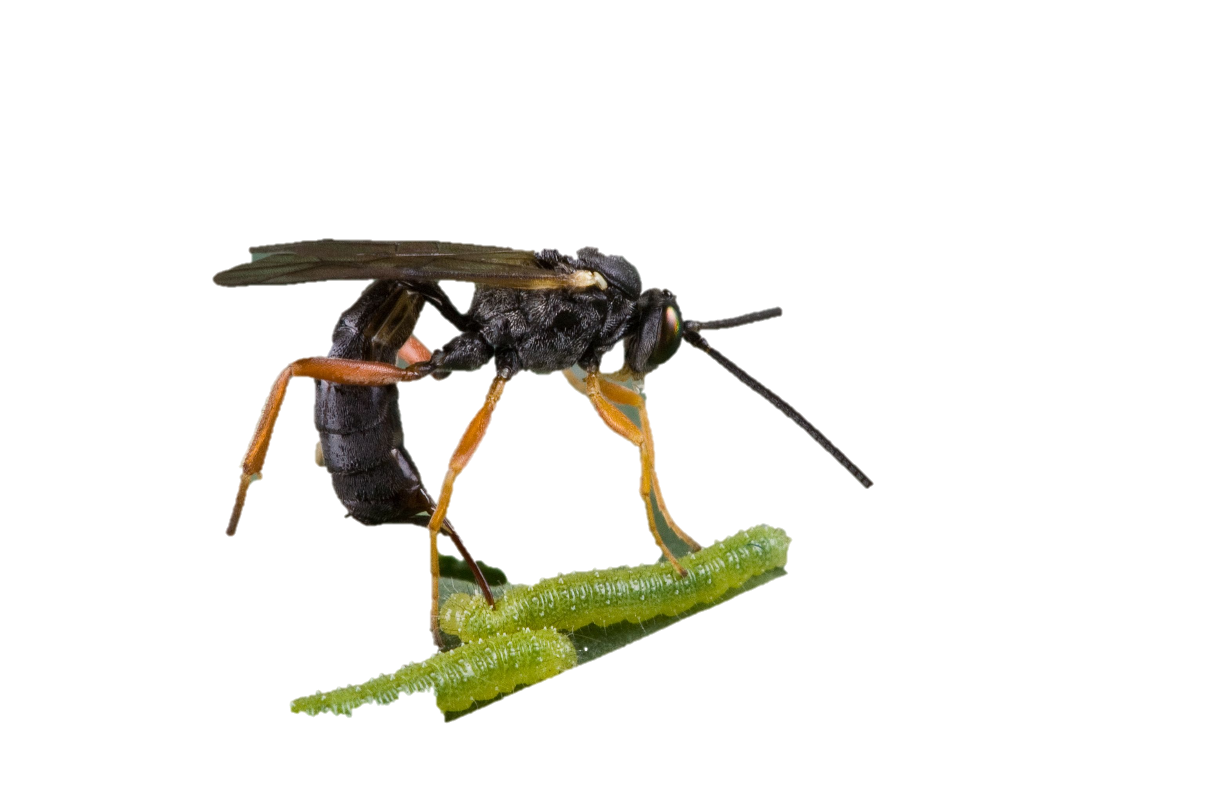
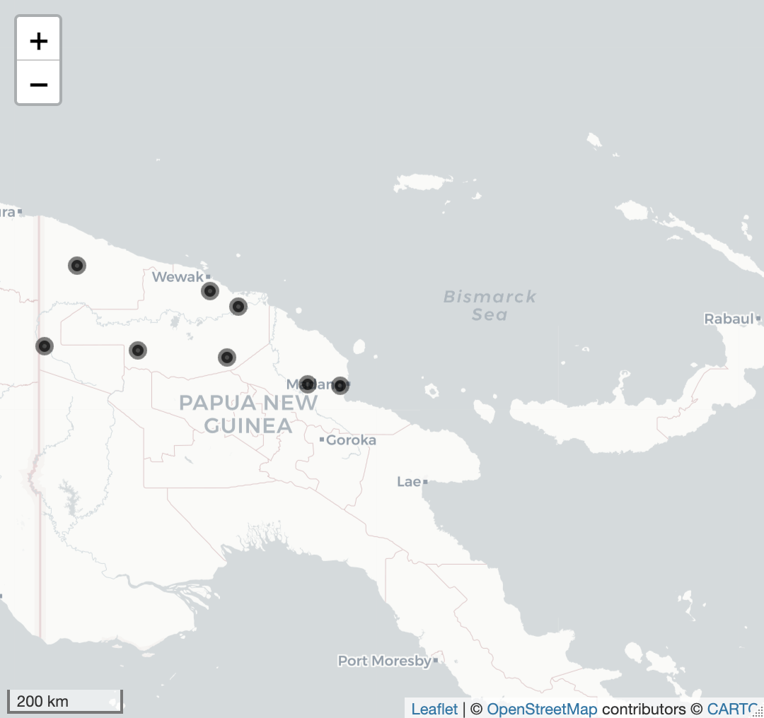
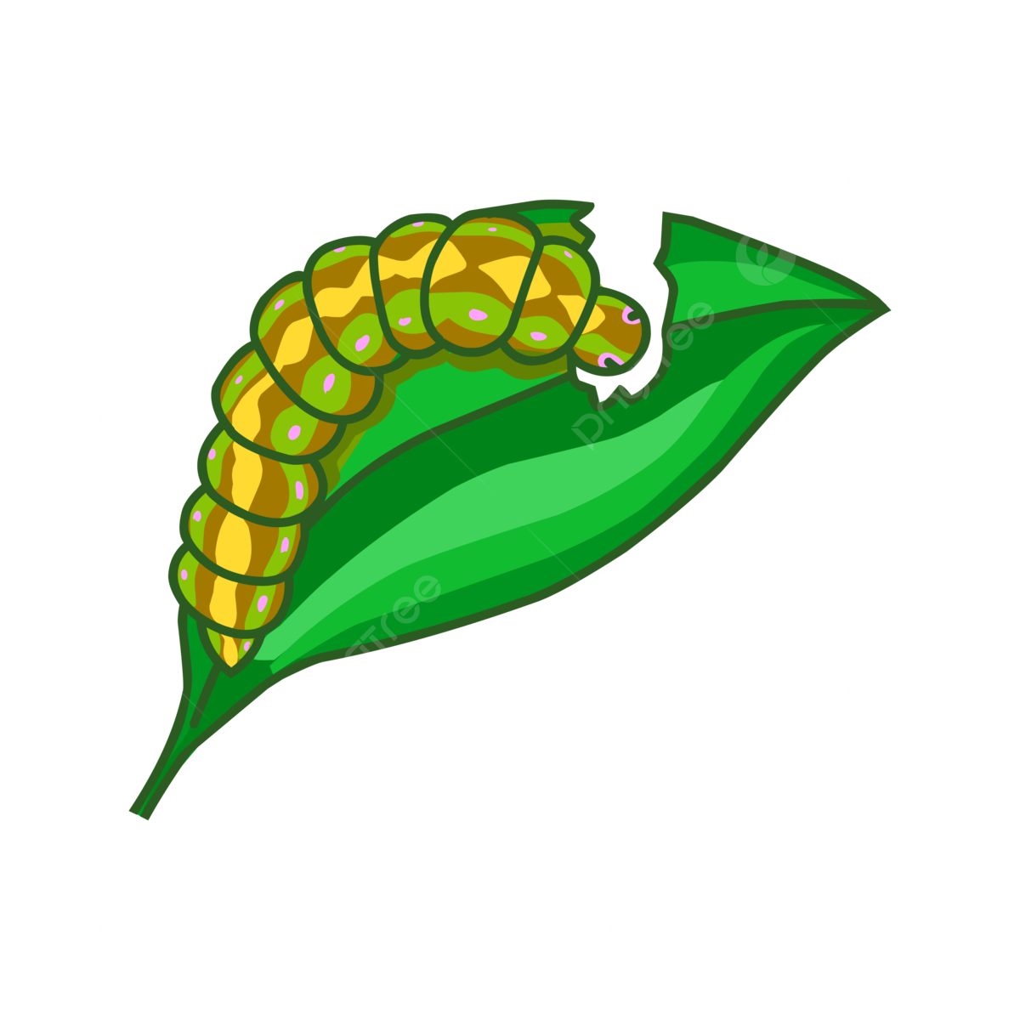
A) Metaweb
C)
D)
B) Papua New Guinea

